Slide 1


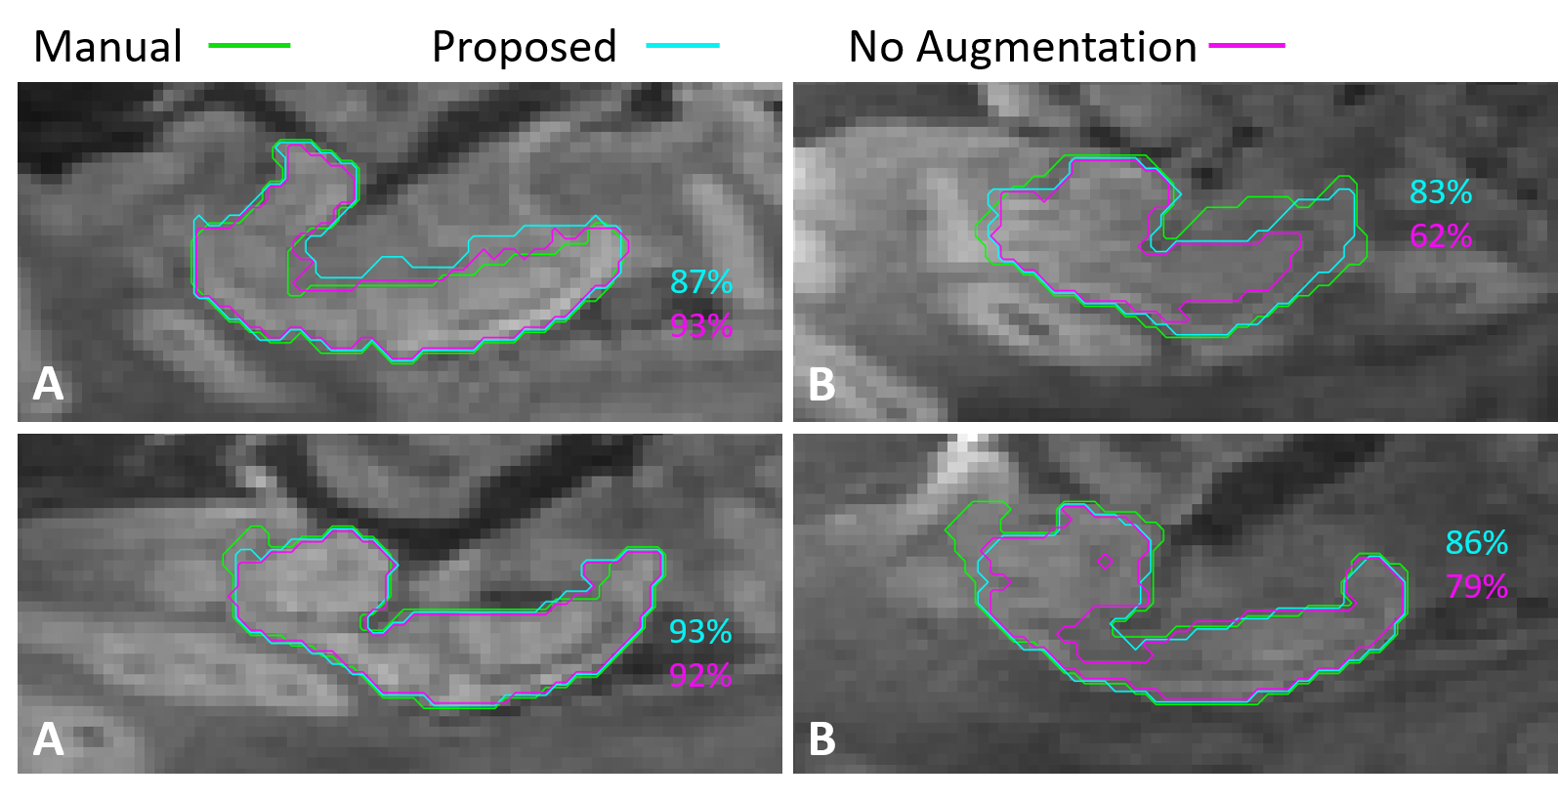
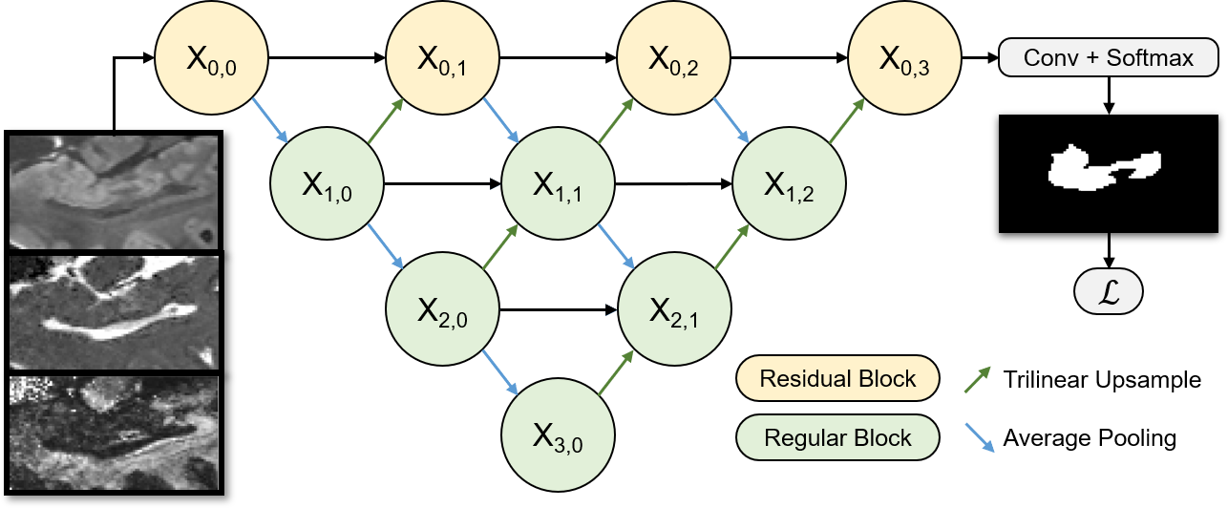
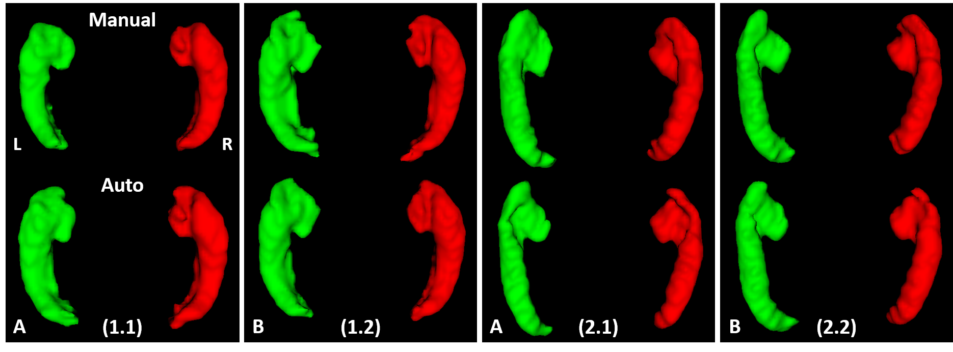
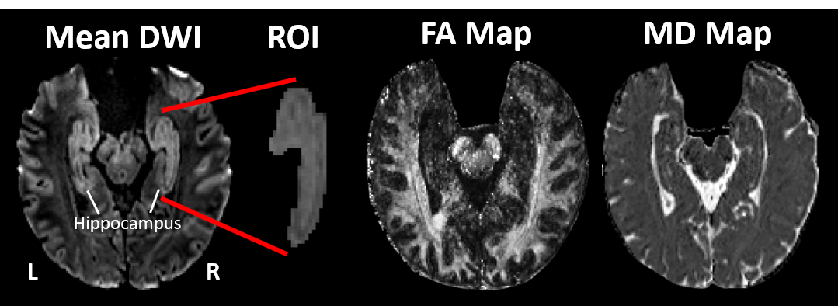
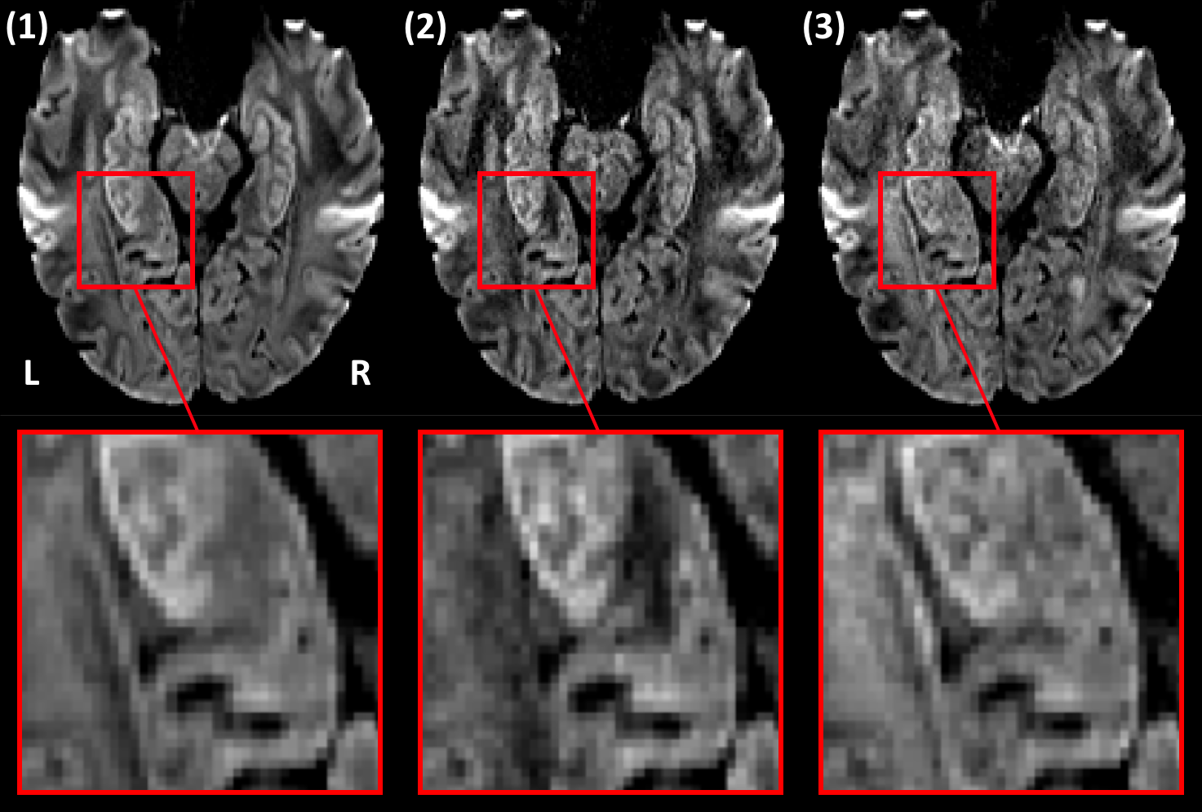
Hippocampus Segmentation on High Resolution Diffusion MRI
C. Efird¹, S. Neumann¹, K. G. Solar², C. Beaulieu², D. Cobzas¹²
1 MacEwan University, Edmonton, Canada
2 University of Alberta, Edmonton, Canada
Abstract
We introduce the first hippocampus segmentation method for a novel high resolution (1×1×1mm³) diffusion tensor imaging (DTI) protocol [1]. A new augmentation technique uses subsets of the DTI dataset to create mean diffusion weighted images (DWI) with plausible noise and contrast variations. The augmented DWI along with fractional anisotropy (FA) and mean diffusivity (MD) maps are used as inputs to a powerful convolutional neural network architecture. The method is evaluated for robustness using a second diffusion protocol.
Model
results
Input Channels | Protocol A Dice % | Protocol B Dice %
DWI | 90.9 ± 2.2 | 86.0 ± 7.4
DWI+MD+FA | 90.7 ± 2.2 | 86.8 ± 5.8
DWI* | 88.1 ± 2.2 | 88.2 ± 4.9
DWI*+MD+FA | 89.7 ± 2.2 | 88.4 ± 3.0
DWI*+MD*+FA* | 89.7 ± 2.3 | 88.8 ± 4.4
An experiment which tests augmentation with different input channels is shown in Table 1.
DWI with no augmentation does not generalize to protocol B.
An augmented DWI with unmodified MD and FA provides the best performance on both protocols.
MD and FA augmentation performs similarly but takes longer to train.
Table 1 - Dice scores for different input combinations with or without augmentation. A * specifies the channel was augmented, and an underline highlights the proposed method.
Figure 1 – Contours from 2 models with and without augmentation, overlayed on mean DWIs for 4 validation subjects. The dice scores correspond to the full volume. Images are marked with an A or B to denote the diffusion protocol.
Data
Each block has a typical [Conv → BN → ReLU] × 2 topology.
Residual blocks have a second path with a single convolution that is added to the block output. This establishes the primary linear path for gradient propagation.
If a block has multiple inputs, they are concatenated.
Dropout with a probability of 0.2 is used to reduce overfitting.
Figure 1 shows a visual comparison of the augmentation technique.
No-augmentation model only performs well on protocol A.
Proposed technique prevents major segmentation failures on protocol B.
Augmentation
In Figure 2, two subjects scanned on both protocols are compared.
DTI captures small bumps and cavities in the hippocampal surface.
Shape and volume are consistent across protocols.
A mean diffusion weighted image (DWI) is the primary input to the network.
Additional fractional anisotropy (FA) and mean diffusivity (MD) maps from the DTI model are evaluated as input channels.
A high (1×1×1mm³) resolution was accomplished with a 5-minute scan time by limiting the coverage area to a slab of twenty slices. Final volume size: 220×216×20mm³.
Two variants of the protocol were used (A and B). The network is trained on A (133 subjects), then validated on A and B (20 and 16 subjects respectively).
Figure 2 - 3D surface renderings of manual and automatic ROIs for two subjects. Note that scans (X.1), (X.2) are repeat scans of
subject X on both protocols. Images are marked with an A or B to denote the diffusion protocol.
Conclusions
The proposed method enables hippocampus segmentation on images obtained from a novel high resolution DTI protocol.
Previous methods that use co-registered anatomical T1 or T2 images are susceptible to errors and capture less structural detail.
Augmentation is a viable approach for increasing robustness of auto segmentation networks.
Future studies will evaluate the performance on pathological data.
Acknowledgements
We acknowledge the Peter S. Allen MR Research Centre at the University of Alberta for creating and sharing the dataset.
Why not use a co-registered anatomical T1 or T2 image?
Registration is susceptible to errors and partial volume effects, which limits the accuracy of DTI studies.
The DTI pipeline captures more microstructural details when compared to anatomical T1 or T2 images.
Reference
[1] S. Treit et al., “High resolution in-vivo diffusion imaging of the human hippocampus,” NeuroImage, vol. 182, pp. 479–487, 2018.
A mean DWI (1) is augmented (2) (3) by randomly excluding images from the mean.
Creates plausible variations to contrast and noise.

Slide 2
DMRI Hippocampus Segmentation
C. Efird¹, S. Neumann¹, K. G. Solar², C. Beaulieu², D. Cobzas¹²
1MacEwan University, Edmonton, Canada
2University of Alberta, Edmonton, Canada
ABSTRACT
You may edit the size of the font, the sections distribution and the color scheme if wanted. All modifications concerning the background/title display are to be done at a Master Slide level.
Results
Importing / inserting files:
Images such as photographs, graphs, diagrams, logos, etc, can be added to the poster. Avoid long numerical tables as they will be difficult to read.
To insert images, go through the menus as follows: Insert / Picture / From File. Locate the file on your computer, select and press OK. Please ensure all image files are JPEG/PNG, other formats may cause images to get corrupted after saving.
Be aware of the image size you are importing.
Notes about graphs…
For simple graphs use MS Excel, or create the graph directly in PowerPoint.
Graphs created in a scientific graphing program (e.g.. Sigma Plot, Prism, SPSS, Statistics) should be saved as JPEG or TIFF.
Data
How to use this poster template:
Highlight this text and replace it by typing in your own text, or copy and paste your text from a MS Word document or a PowerPoint slide presentation.
The body text / font size should be no smaller than 20 points. Keep body text left-aligned, do not justify text.
The recommended font for captions is Calibri, no smaller than 15 pt. Left aligned if it refers to a figure on its left. Start the captions right at the top edge of the picture (graph or photo).
The recommended font for captions is Calibri, no smaller than 15 pt. Left aligned if it refers to a figure on its left. Start the captions right at the top edge of the picture (graph or photo).
Method
Tips for making a successful poster:
Re-write your paper into poster format i.e.. simplify everything, avoid data overkill.
Headings of more than 6 words should be in upper and lower case, not all capitals. Simplify the titles.
Do to write whole sentences in capitals or underline to stress your point, use bold characters instead.
When laying out your poster, leave white space around your text. Don’t overcrowd your poster.
Spell check and get someone else to proof-read.
Conclusions
Highlight this text and replace with your own text.
References
Highlight this text and replace with your own text.
Can be Vancouver style i.e. 1 Meyer J-P et al. The treatment of high-grade superficial bladder cancer and carcinoma in situ with BCG – a questionnaire survey of Consultant practice in England and Wales. Urol Oncol 2002; 2;: 77-80
Acknowledgements
Highlight this text and replace with your own text.
CONTACT INFORMATION
Just highlight this text and replace with your own text.

Slide 3
P o s t e r t i t l e g o e s h e r e
Add your logos here
Authors, FIRST NAME INITIAL, SURNAME, presenting author(s) underlined, Affiliations1 numbered in superscript
e.g. B. SMI1University of New South Wales, Sydney, Australia
TH ¹, N. HARRISON ² ² and P. MATTHEWS²
2Royal Brisbane Hospital, Brisbane, Australia
PURPOSE / OBJECTIVES
Use this space to enter key message/main findings. (A short summary to allow viewers to learn about your research)
RESULTS
Copy and paste your text content here, adjusting the font size to fit into the textbox.
Figure 1
EXAMPLE
MATERIAL & METHODS
Video 1
Copy and paste your text content here, adjusting the font size to fit into the textbox.
EXAMPLE
Table 1
EXAMPLE
RESULTS
Copy and paste your text content here, adjusting the font size to fit into the textbox.
SUMMARY / CONCLUSION
Copy and paste your text content here, adjusting the font size to fit into the textbox.

