Slide 1

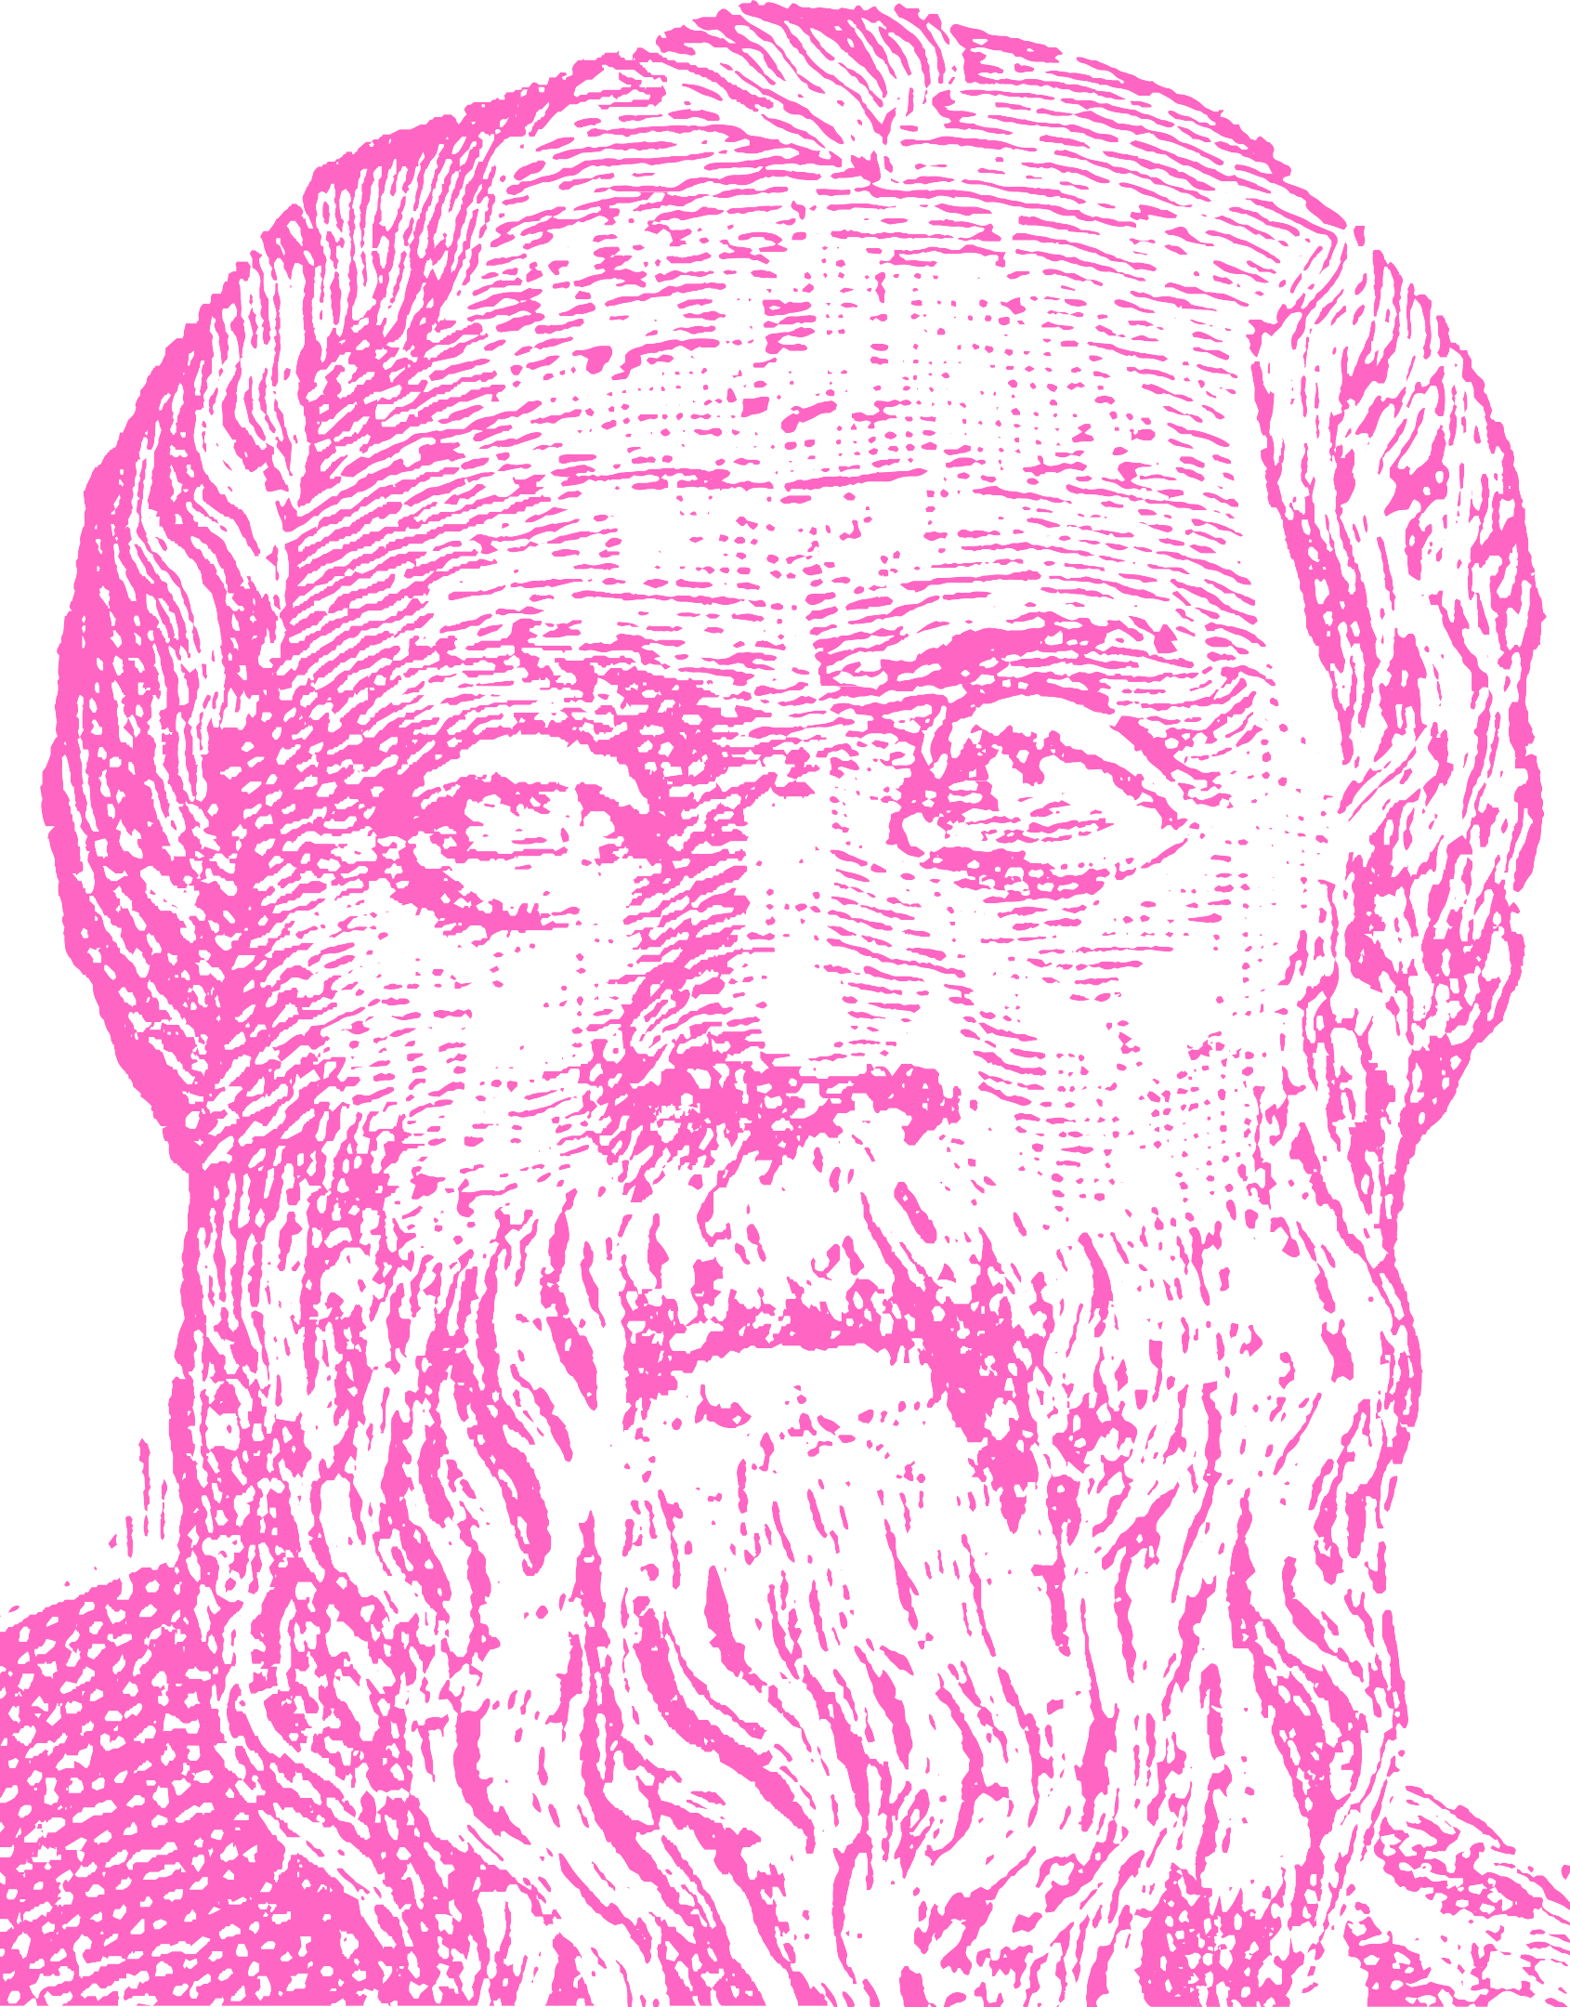

The Heroic Love of Socrates
Plato’s comparison of Achilles, Theseus, and Heracles with Socrates helps distinguish his uniqueness as a heroic lover.
Socrates heroic love is for truth and virtue, but he lacks any ultimate wisdom or proof. Yet Socrates’ lack of proof allows for his heroism as a lover of the soul.
Socrates ignorance and love also provide calmness in facing death. Ignorance of the underworld or any ultimate wisdom leaves Socrates passionately seeking truth and pursuing virtue. This loving pursuit allows repose in facing death.

Slide 2

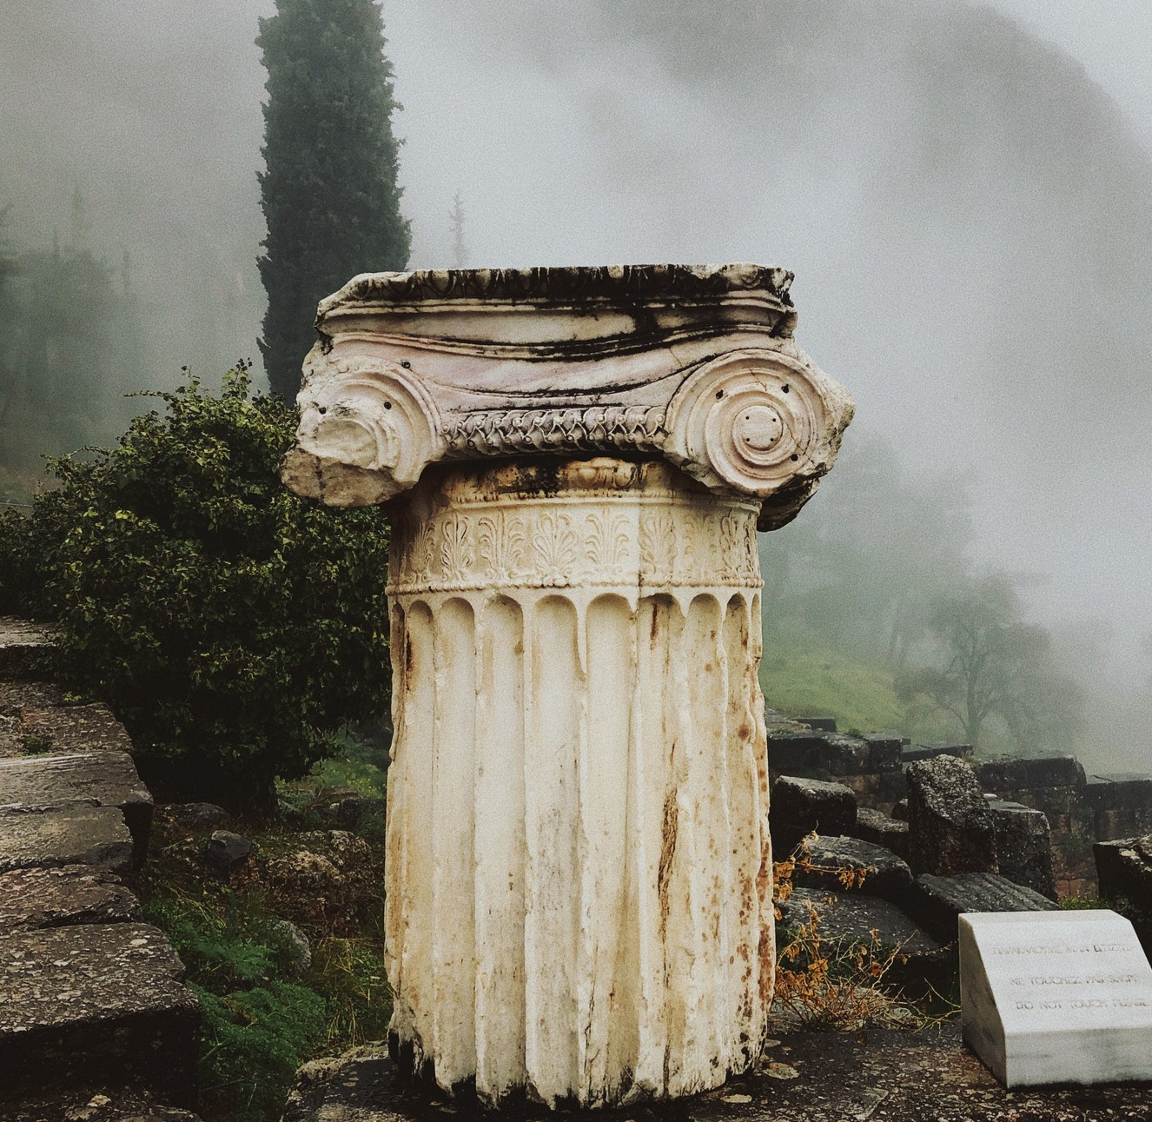
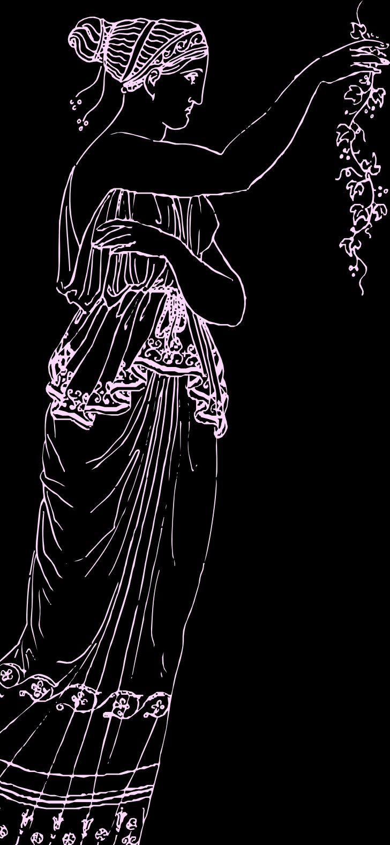
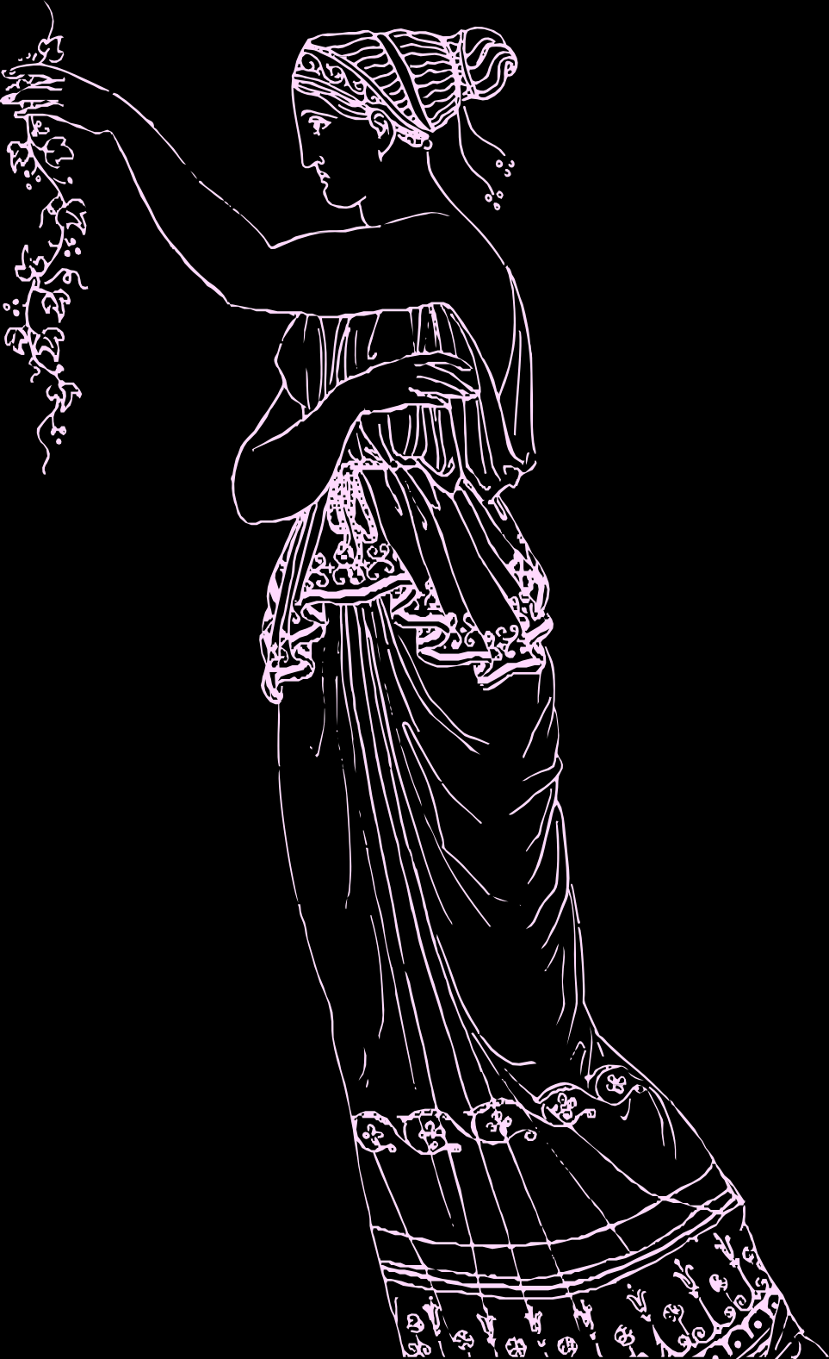
The Oracular Origin of Socrates' Labour
“. . .in fact the god is wise and. . . his oracular response meant that human wisdom is worth little or nothing. . .”(p.27 23-b).
The Delphic oracle declared “. . .no one was wiser [than Socrates].” (26 21-b).
Socrates describes “[he] must give an account of [his] journeyings as if they were labours undertaken to prove the
oracle irrefutable.” (26-27 22-b).
Like a mythic hero Socrates obeys a divine command and faces death calmly. Socrates’ labour is helping others care for
virtue. All are ignorant of ultimate Wisdom, so all ought to seek Truth as lovers without proof.

Slide 3

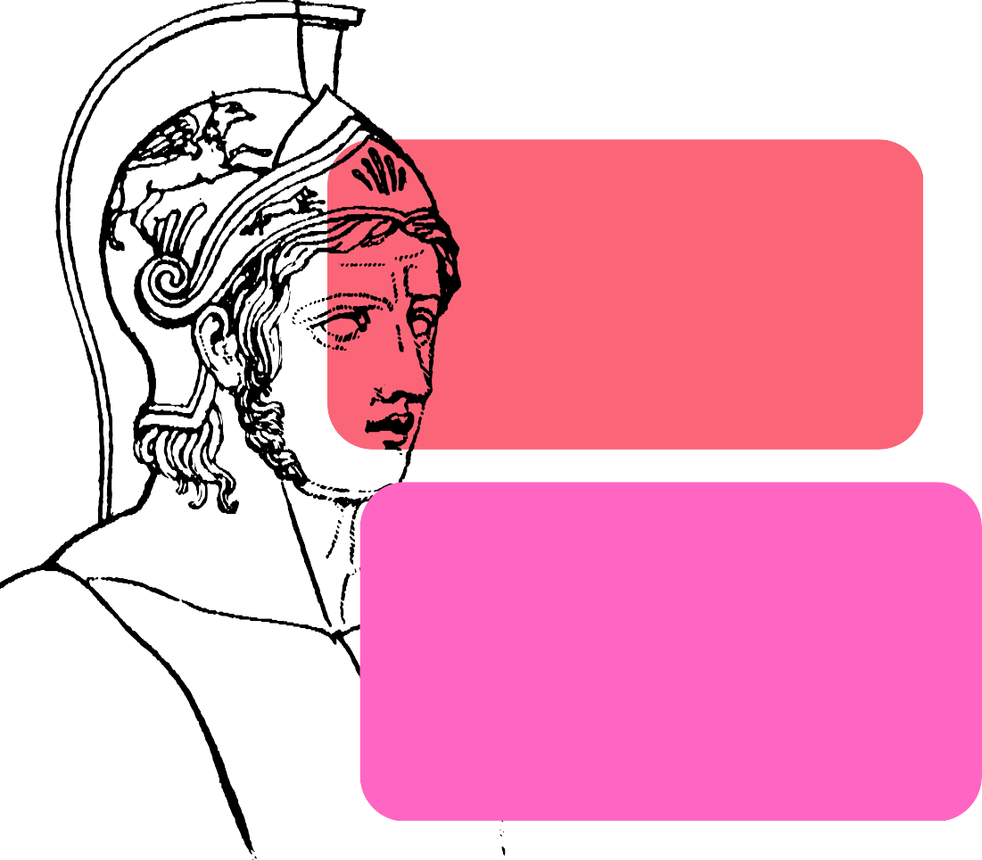

Achilles,Death & Socrates Love of Soul
“To fear death, gentlemen, is none other than to think one knows what one does not know.” (33 29-b).
“For I go around doing nothing but persuading. . .you not to care for your body or your wealth in preference to or as strongly as for the best possible state of your soul.” (34 30-b).
Like Achilles, Socrates labours for a divine command and stands his post to philosophize. Since philosophy is a love of Wisdom, Socrates is unique as a lover of moral well-being and the soul; he faces death as he does not presume it ultimately to be bad because he values virtue—not just the physical body.

Slide 4



A
A daemon (Greek: δαίμον) is a child of the gods between mortal and immortal.
Socrates’ passionate philosophizing is partly due to his inner spiritual daemon guiding him.
Socrates remains ignorant, but his daemon allows him to face death calmly while helping others realize their ignorance.
Daemonic Interlude
“my divine sign has not opposed me.” (43 40-b).
"death is something I couldn’t care less about." (37 32-d).

Slide 5
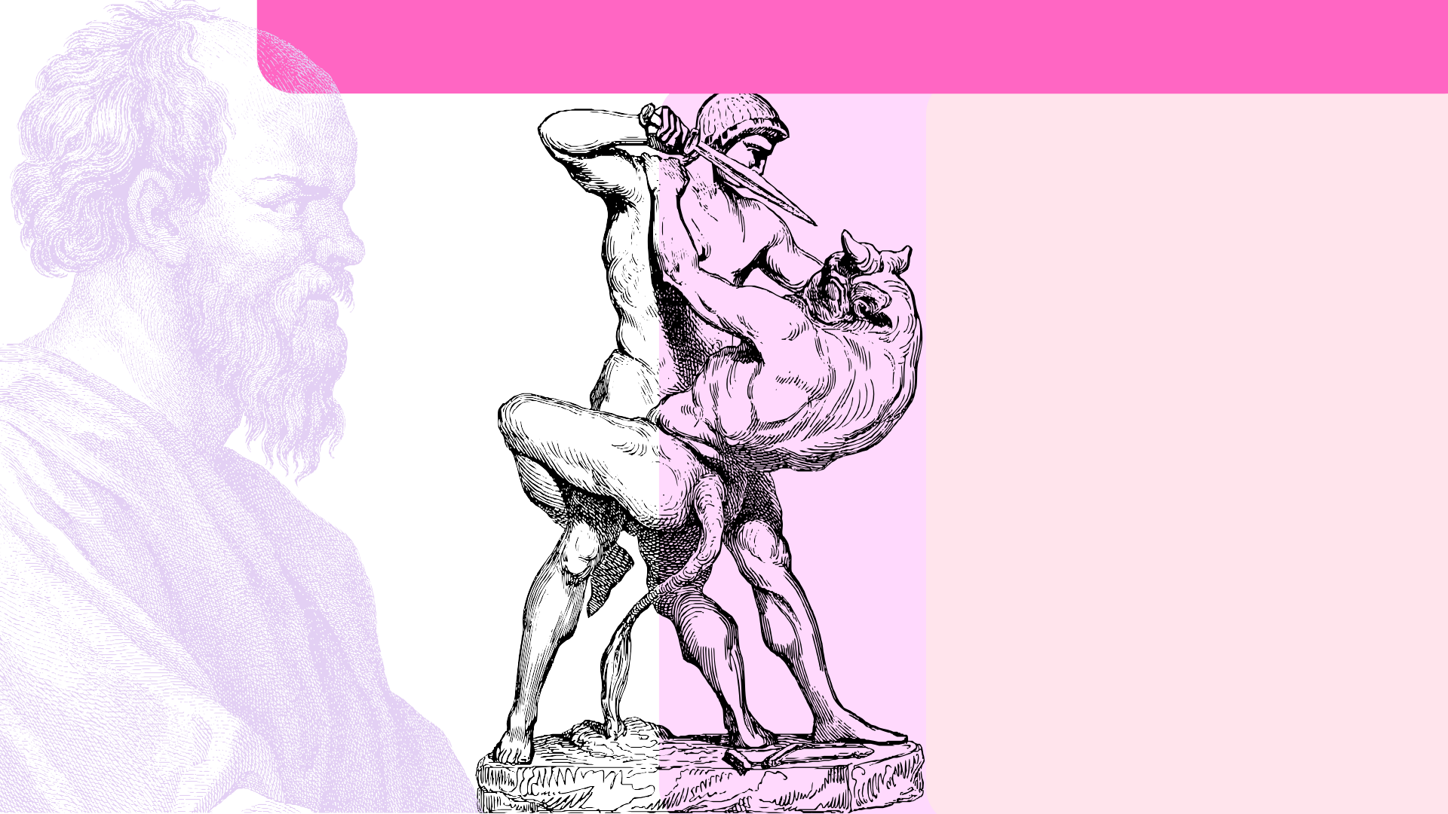

Socrates & Theseus Versus the Minotaur
In the Phaedo, Socrates dies calmly; his heroism is being a saviour of his friends' souls whom he rescues from despair and fear.
Theseus saved people sent to be devoured by the Minotaur.
Socrates conquers different
Minotaurs: the fear of death and despair of seeking Truth.
As a lover, Socrates helps his friends realize they lack ultimate Truth, but they can have calm hope if they continue to love their souls and seek virtue via philosophy.

Slide 6
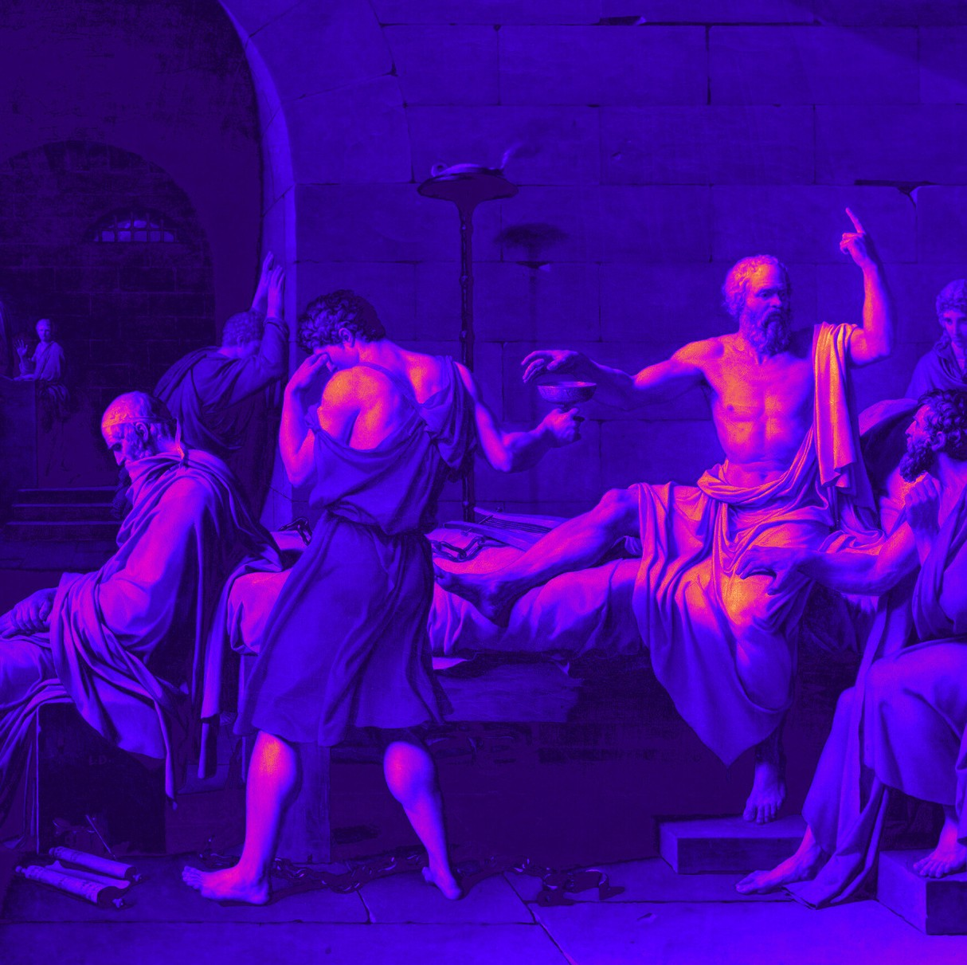
Love of Soul & Body
Socrates heroically rescues his friends’ souls and emotional well-being—like Theseus, “He saved them and was himself saved. (p.95 58-b). Yet he does so lovingly.
The “Minotaur” is Misology—despair of philosophizing when proofs are uncertain.
Socrates eases and inspires his friends not to give up hope or their passion.
“[Socrates] healed our distress and, as it were, recalled us from our flight and defeat and turned us around to join him in the examination and the argument.” (126).
“. . . he stroked my head and pressed the hair on the back of my neck, for he was in the habit of playing with my hair at times.” (127).

Slide 7


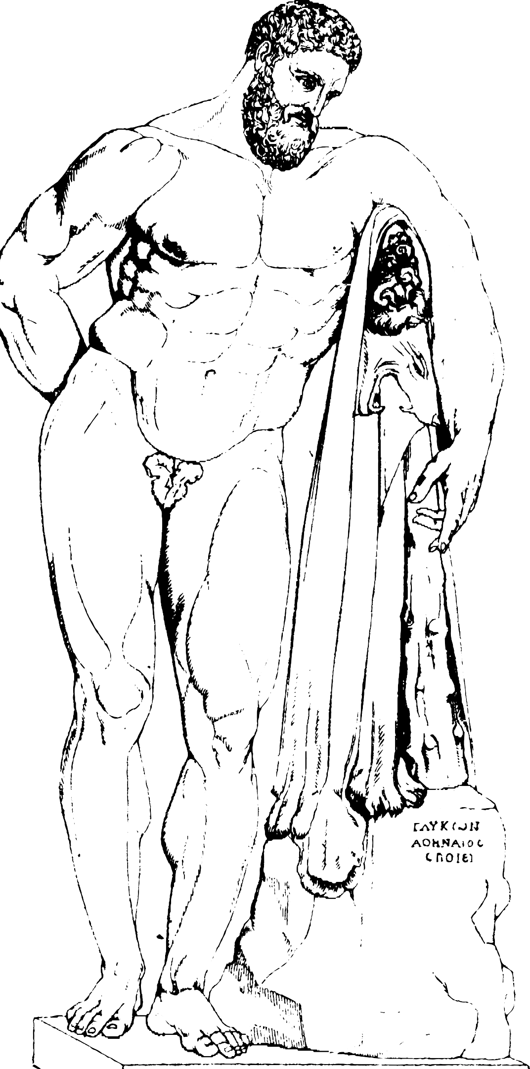


Heracles, Hydra's & Hope
"'. . . not even Heracles could fight two people. Then call on me as your Iolaus, as long as the daylight lasts.'" (p.127 89-c).
As his friends despair over
for
uncertain proofs immortality, Socrates further
displays his love of care and mentions the hero Heracles, who overcame a hydra with Iolaus.
Socrates’ labour is to overcome the hydra of arguments and save his friends by inspiring them to seek virtue and passionately philosophize even without proof.

Slide 8
"If you take my advice you will give little thought to Socrates and much more to the Truth.” (p.129 91-c).

Slide 9
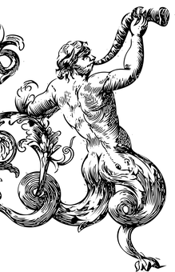
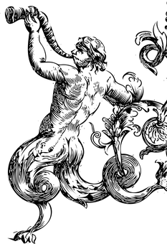
"This Truly Daemonic man" (p.55)
"'But you wouldn’t come close to finding the sort of human this one here has proved to be in all his strangeness—he and those speeches of his—whether you searched among men of today or those of antiquity. . . unless you liken him in himself and in his speeches not to any humans but, as I say, to the silenuses and satyrs.'" (pp.57-58 221D-221E)

Slide 10
Works Cited:
Faculty Mentor: Dr. Cyrus Panjvani
Plato, Symposium: Or Drinking Party,Translated by Eva Brann, Peter Kalkavage and Eric Salem, Focus Philosophical Library, 2017. pp.55-58.
Plato, Five Dialogues: Euthyphro, Apology, Crito, Meno, Phaedo. Translated by G.M.A. Grube, Hackett Publishing Company, 2002. p.7-129

