Slide 1



Empowering Course Design with Open Educational Resources (OER) in Learning Management Systems (LMS)
Shahram Fardadvand, BAIST, SMIEEE (He, Him)
Educational Technologist
Centre for Teaching and Learning
MacEwan University

Slide 2



What are Open Educational Resources (OER)?
Open Educational Resources (OER) are freely available and openly licensed teaching, learning, and research materials that can be used, adapted, and shared with minimal restrictions. These resources enhance accessibility, affordability, and innovation in education by allowing educators to customize content for diverse learning needs.
OER on the Pressbooks
Pressbooks is a widely used digital publishing platform for creating and distributing OER, particularly open textbooks. As of the latest data:
The Pressbooks Directory hosts over 8,000 open access books.
500 institutions worldwide use Pressbooks to publish and share OER.
https://pressbooks.directory/

Slide 3
The Pedagogical Value of OER in LMS
Traditional Approach: Linking to an OER
Faculty provide a URL to the OER on the course dashboard.
Students navigate away from the LMS to read the textbook.
Some OER offer downloadable formats (PDF, EPUB, XML), but learners still consume content externally.
Challenges:
  Fragmented learning experience – students switch between platforms.
  Limited engagement tracking – no visibility into student interactions with the material.
  Reduced interactivity – static resources without integrated activities.
Enhanced Approach: Embedding OER Directly in LMS
OER content is imported into the LMS, ensuring seamless integration.
Faculty can embed interactive elements (quizzes, discussions, learning activities) alongside the reading.
Benefits for Learning:
  Continuity – All course materials are in one platform.
  Student Engagement – Activities and assessments connect directly to readings.
  Accessibility – LMS tools enhance usability for all learners.
  Analytics & Academic Integrity – Track student engagement and reading progress.

Slide 4
Two Approaches to Using OER in LMS
Feature | Linking to OER (External) | Integrating OER into LMS
Student Experience | Navigates between platforms, potential distractions | Seamless access in LMS
Engagement | Passive reading, less structured activities | Active learning strategies can be applied (quizzes, discussions, assignments integrated with the reading).
Accessibility | Depends on Pressbooks | LMS-controlled accessibility tools (e.g. Immersive Reader)
Analytics & Tracking | No insights into student engagement | LMS analytics track student progress

Slide 5




What is a Common Cartridge?
A Common Cartridge (.imscc) is a structured file format used to package and share course content across different Learning Management Systems (LMS).
It allows seamless import of course contents into LMS platforms like Moodle, D2L, Canvas and Blackboard.

Slide 6
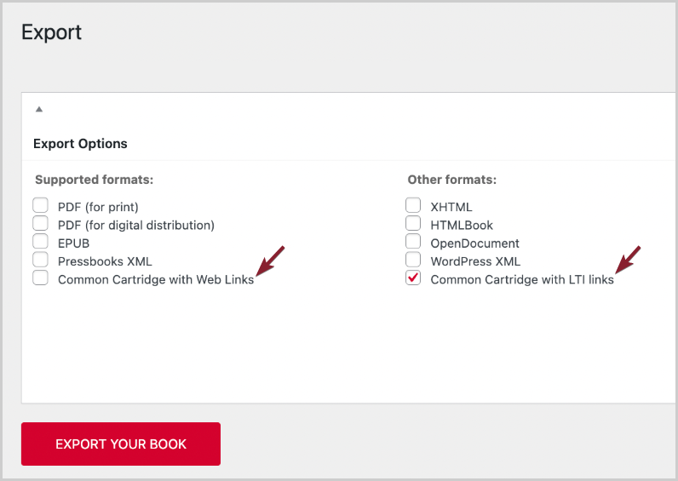
How Pressbooks Supports Common Cartridge (.imscc) Files?
Pressbooks enables Authors and Institutions to make OER textbooks available in various formats, including Common Cartridge (.imscc) for others to download and use.
Common Cartridge with Web Links
Common Cartridge with LTI Links (Deep Linking)

Slide 7
Common Cartridge (Web Links) VS (LTI Links) ?
Common Cartridge with Web Links
No need for institutional support.
Allow educators to embed content easily into courses.
Simple Import.
Common Cartridge with LTI Links (Deep Linking)
Requires institutional support for implementation.
Enables integration of interactive content, such as H5P activities.
Allows these activities to be incorporated as graded assessments within the LMS.
Complex Import with Institutional Support.

Slide 8
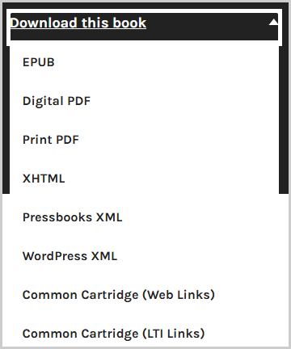

How to find Common Cartridge Files to Download?
Go to the Pressbooks Directory and find an open textbook.
Check for available download formats (some books offer Common Cartridge).
Download the (.imscc) file and save it for LMS import.
Not all books offer the Common Cartridge for download. You may need to contact the publisher, institution, or author of the book to request this format to be available for download

Slide 9

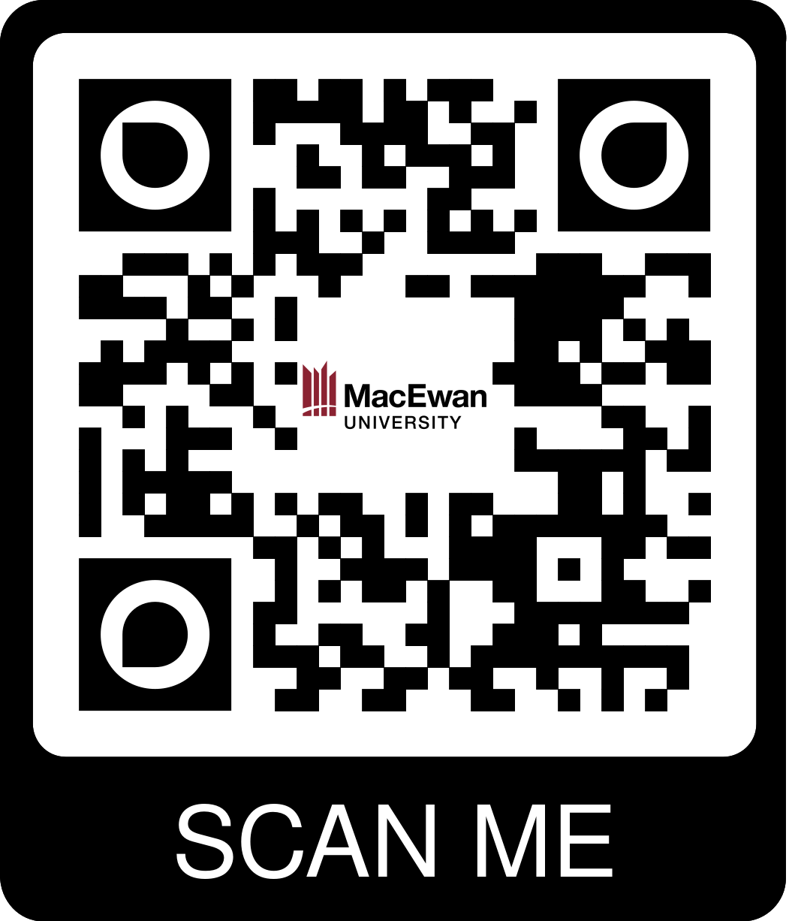

How to Import Common Cartridge File into Learning Management Systems (LMS)?
Use this guide for downloaded Common Cartridge (Web Links) and not LTI Links. For LTI Links contact your OER team.

Slide 10
Common Questions from Educators Integrating OER into LMS
If the book is updated, will I need to import the new Common Cartridge file into my course again?
Can I import the Common Cartridge into an existing course that I have already designed?
I want to use multiple OER books in my course. How can I do that?
How will learners interact with H5P activities after import?

Slide 11

Thank You!

