Slide 1
Exploring Social Isolation Among Black Parents Who Have Children with Autism: A Research Proposal
PRESENTED BY:
JOJO BOATENG
boatengj3@mymacewan.ca
April 19, 2024

Slide 2
Jojo Boateng
Research Proposal
Agenda
    Introduction
    Literature Review
    Methodology
    Conclusion
    Q&A
009
010
011

Slide 3

Jojo Boateng
Research Proposal
Introduction
“...We want to create a culturally safe environment that acknowledges, honours and respects the lived experience of every person and community.” (Autism Edmonton, n.d.)
009
010
011

Slide 4
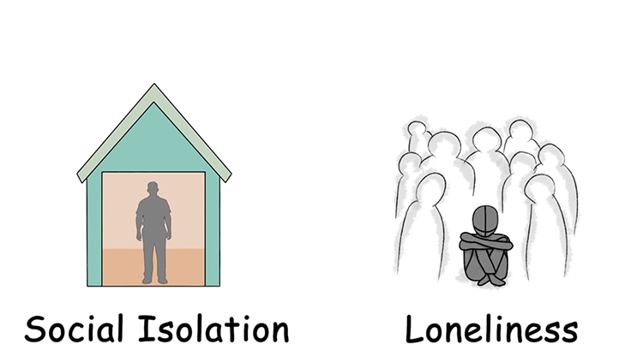
Jojo Boateng
Research Proposal
(de Jong-Gierveld et al., 2006; McPherson & Smith-Lovin, 2006; Sanders et al., 2022)
009
010
011

Slide 5
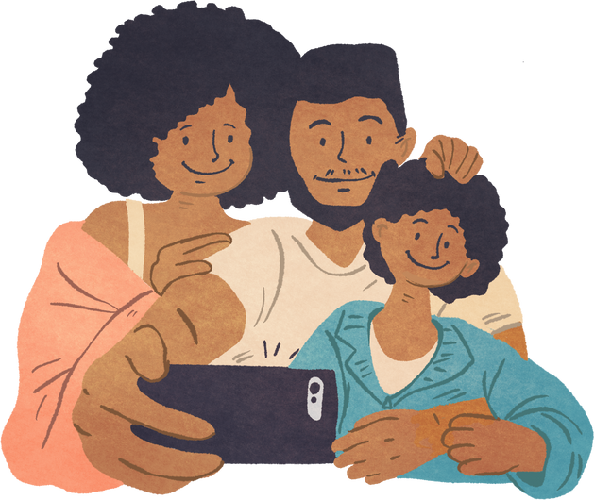
Jojo Boateng
Research Proposal
Literature Review
  Black parents = Black + parents, and their experience is dependent on this distinction (Annamma et al., 2013; Pearson et al., 2023; Williams et al., 2022)

Slide 6
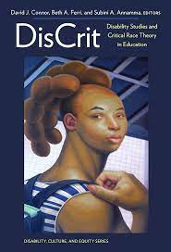
Jojo Boateng
Research Proposal
Literature Review
Autism
Have weaker social networks (Yi & Siu, 2021)
Disable-adjacent identities
DisCrit is the most suitable framework
"Parents raising children [with autism] disrupt able-bodied and [racial] conceptualization of normalcy" (Pearson et al., 2023, p. 4).
Face the same discrimination (Pearson et al., 2023; Selman et al.)
009
010
011

Slide 7
Jojo Boateng
Research Proposal
How do Black parents who have children with autism understand social isolation?
009
010
011

Slide 8

Jojo Boateng
Research Proposal
Methodology
  Phenomenology (Abdulai & Owusu-Ansah, 2014; Creswell, 2018; Sharan & Tisdell, 2015; Starks &Trinidad, 2007)
  Recruited through Autism Edmonton
  Focus groups of Black parents who have children (5-10 years old) with autism
  Vignettes
Notes:
Might need to take out focus groups
After coming home from celebrating a night out with your friends, you return home to find your babysitter upset. When you ask what is wrong, they say your child (Alex) is “too difficult to handle.”
How would this make you feel?

Slide 9
Jojo Boateng
Research Proposal
Vignette Example
After coming home from celebrating a night out with your friends, you return home to find your babysitter upset. When you ask what is wrong, they say your child (Alex) is “too difficult to handle.”
Notes:
Might need to take out focus groups
After coming home from celebrating a night out with your friends, you return home to find your babysitter upset. When you ask what is wrong, they say your child (Alex) is “too difficult to handle.”
How would this make you feel?

Slide 10

Jojo Boateng
Research Proposal
Limitations
Future Directions
Conclusion
009
010
011
Notes:
Fix slide (based on future direction)

Slide 11
Jojo Boateng
Research Proposal
References
Abdulai, R. T., & Owusu-Ansah, A. (2014). Essential Ingredients of a Good Research Proposal for Undergraduate and Postgraduate Students in the Social Sciences. SAGE Open, 4, 1-15. 10.1177/2158244014548178
Annamma, S. A., Connor, D., & Ferri, B. (2013). Dis/ability critical race studies (DisCrit): theorizing at the intersections of race and dis/ability. Race Ethnicity and Education, 16(1), 1-31. http://dx.doi.org/10.1080/13613324.2012.730511
Autism Edmonton. (n.d.). About Us. Autism Edmonton. https://www.autismedmonton.org/about-us/
Creswell, J. W. (2018). Qualitative Inquiry & Research Design: Choosing Among Five Approaches (2nd ed.). SAGE Publications.
De Jong-Gierveld, J., van Tilburg, T. G., & Dykstra, P. A. (2006). Loneliness and social isolation. In D. Perlman, & A. Vangelisti (Eds.), The CambrParigi, P., & Henson II, W. (2014). Social Isolation in America. Annual Review of Sociology, 40(1), 53-71. 10.1146/annurev-soc-071312-145646
McPherson, M., Smith-Lovin, L., & Brashears, M. E. (2006). Social Isolation in America: Changes in Core Discussion Networks over Two Decades. American Sociological Review, 71(3), 353-375.
Pearson, J. N., Malone, K. M., Stewart-Ginsburg, J. H., Manns, L. D.C., Martin, D. M., & Palazzo, K. M. (2023). “We Should All Be Welcome:” A Discourse Analysis of Religious Coping for Black Parents Raising Autistic Children. Journal of Disability & Religion, 1-25. https://doi.org/10.1080/23312521.2023.2178993
idge Handbook of Personal Relationships (pp. 485-500). Cambridge University Press.
Sanders, R., Lehmann, J., & Gardner, F. (2022). Parents’ Emotional Responses to Early Parenthood. Journal of Family Issues, 43(7), 1874-1897. 10.1177/0192513X211030024
Williams, M. T., Roy, A. K., Maclntyre, M.-P., & Faber, S. (2022). The Traumatizing Impact of Racism in Canadians of Colour. Current trauma reports, 8(2), 17-34. 10.1007/s40719-022-00225-5
Yi, H., & Siu, Q. K.Y. (2021). “His inner-self must be good”: An ethnographic vignette study of social interactions between children with autism spectrum disorder and typically developing peers. Journal of Social and Personal Relationships, 38(1), 232-255. 10.1177/0265407520959456
Starks, H., & Trinidad, S. B. (2007). Choose Your Method: A Comparison of Phenomenology, Discourse Analysis, and Grounded Theory. Qualitative Health Research, 17(10), 1372-1380. 10.1177/1049732307307031
Notes:
FIX REFRENCES -> make sure you have them all

Slide 12
Jojo Boateng
Research Proposal
Questions?
Jojo Boateng
boatengj3@mymacewan.ca
Notes:
Add Edmonton autism

